Slide 1
WORK PRESENTATION
By
Sahana G
20.07.2019
Notes:
Give prelude - paper
MVR, Ribbon synapse
Dependence on contrast / current stimulus.
ribbon synapses of bipolar cells recode an analog signal (PRE.ica) for transmission across the synapse.
Number vs quanta releases - dec, ISI - almost same - INDIVIDUAL ACTIVE ZONE

Slide 2
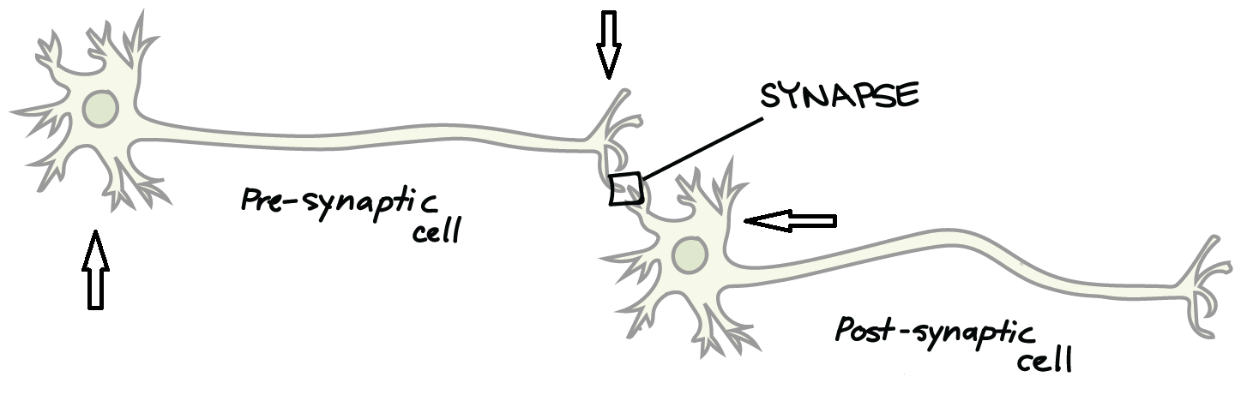
L type Calcium channel is introduced in the presynaptic terminal.
Postsynaptic voltage and firing frequency are observed.
Step like Current clamp given as stimulus.
https://www.khanacademy.org/science/biology/human-biology/neuron-nervous-system/a/the-synapse

Slide 3
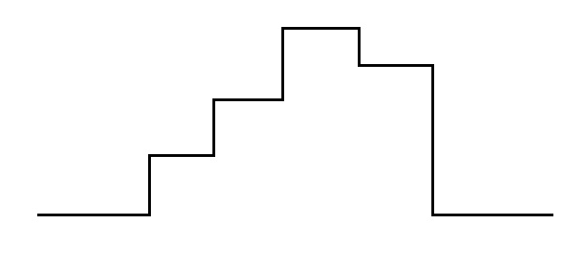
STEP 1 - Building the Presynaptic neuron
SOMA
AXON
TERMINAL
Current Clamp of this fashion (step-like) was given at the centre of somatic compartment.
Soma and Axon were given passive properties.
Notes:
0.39, 0.5, 0.46, 0.37, 0.4

Slide 4
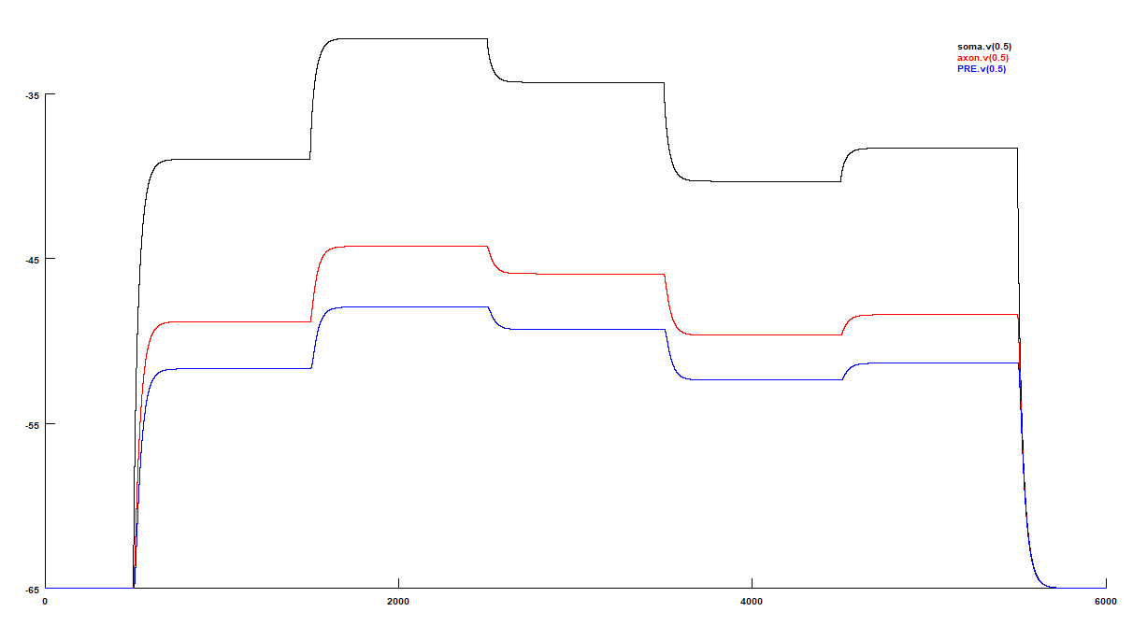
Voltage recordings from Presynaptic neuron

Slide 5
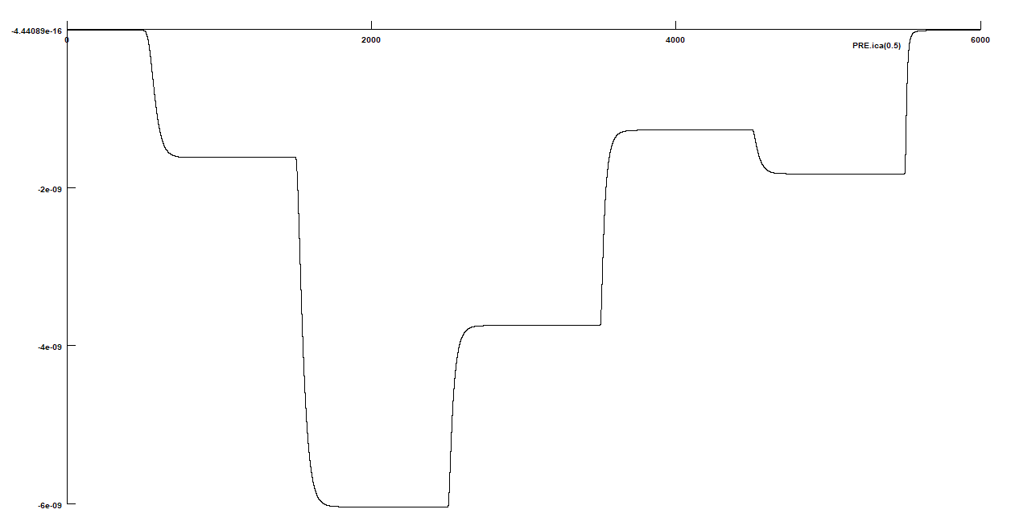
STEP 2 - Insert L Type Calcium channel at Presynaptic terminal
Characteristics
It is a non activating and long lasting channel.
It is a high voltage activator channel, hence conductance across this channel reaches maximum at suprathreshold potentials.
Notes:
Explain about fliping and scaling it to (0,10)

Slide 6
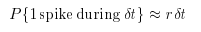
Poisson Spike Train Generation
For any time varying function, r(t), with time step = dt, the Probability density function can be written as -
To include stochasticity, if this probability is lesser than a random number generated between 0 - 1, a spike is generated.
When repeated over multiple trials, and summing them up together, gives us Poisson Spike Train.
https://www.cns.nyu.edu/~david/handouts/poisson.pdf
Notes:
Independent spike hypothesis. Refractory period - not poisson - I have ignored the refractory part assuming that the ribbon synapse is really quick.
A Poisson Process is a model for a series of discrete event where the average time between events is known, but the exact timing of events is random.

Slide 7
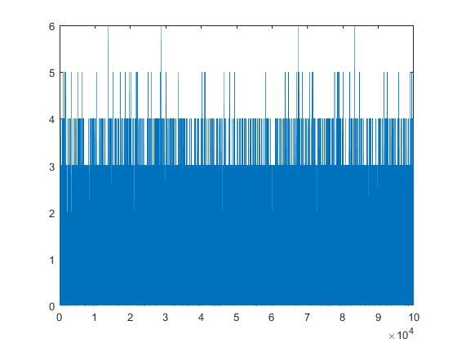
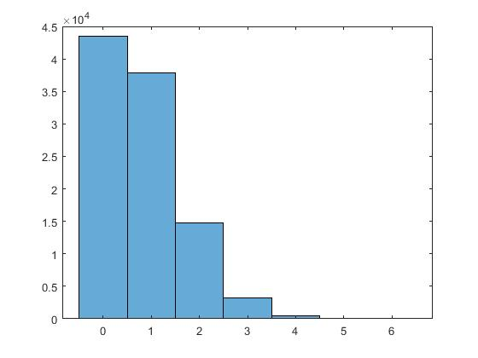
For example, consider r(t) = 80.
Total time = 100 seconds. Discrete time interval = 1 millisecond.
Let us generate Poisson spike train for the given r(t).

Slide 8
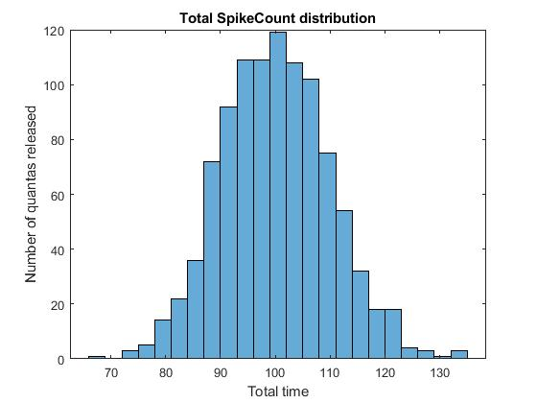
As frequency of r(t) increases, the Spike count distribution becomes gaussian from being exponential.
The mean and variance of this distribution should be approximately the same.

Slide 9
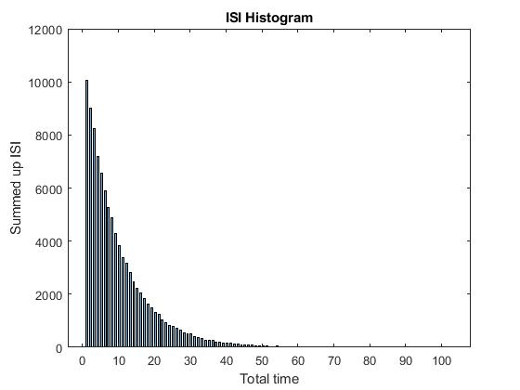
When histogram for Inter Spike Interval (ISI) for the above distribution is plotted, we get an exponential trace.
The mean and standard deviation of this plot was approximately the same.

Slide 10
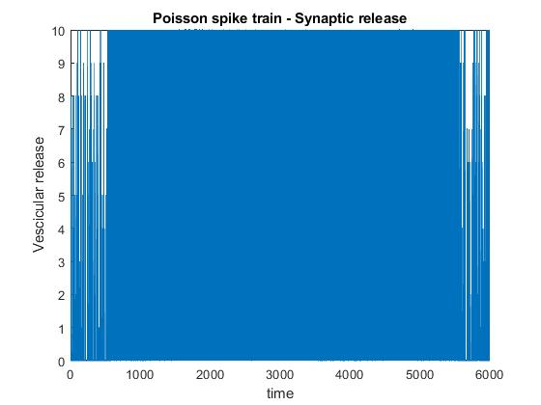
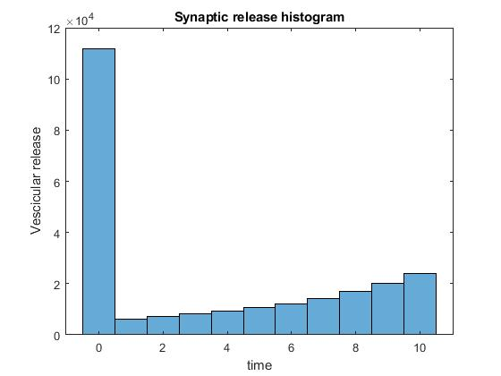
STEP 3 - Convert Calcium Current to Stochastic Synaptic release by generating Poisson Spike Train

Slide 11
STEP 4 - Building the Postsynaptic compartment
It is a single compartment.
It has Na and KDR channels from CA1 Pyramidal cells.
A current clamp was given at the centre of the compartment.
Firing frequency, steady state voltage (maximum voltage) and Input resistance were recorded from this compartment.
POST

Slide 12
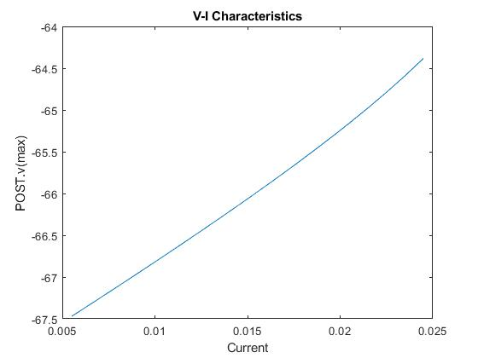
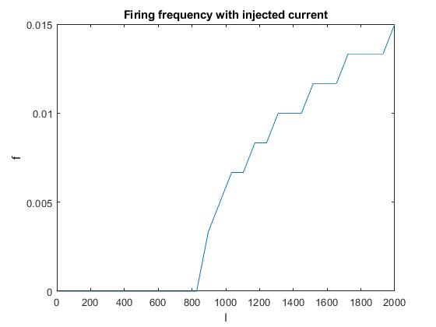
STEP 4.5 - Characterization of Postsynaptic compartment
Slope of the V-I Characteristics = Input resistance = 150.1856 M ohms

Slide 13
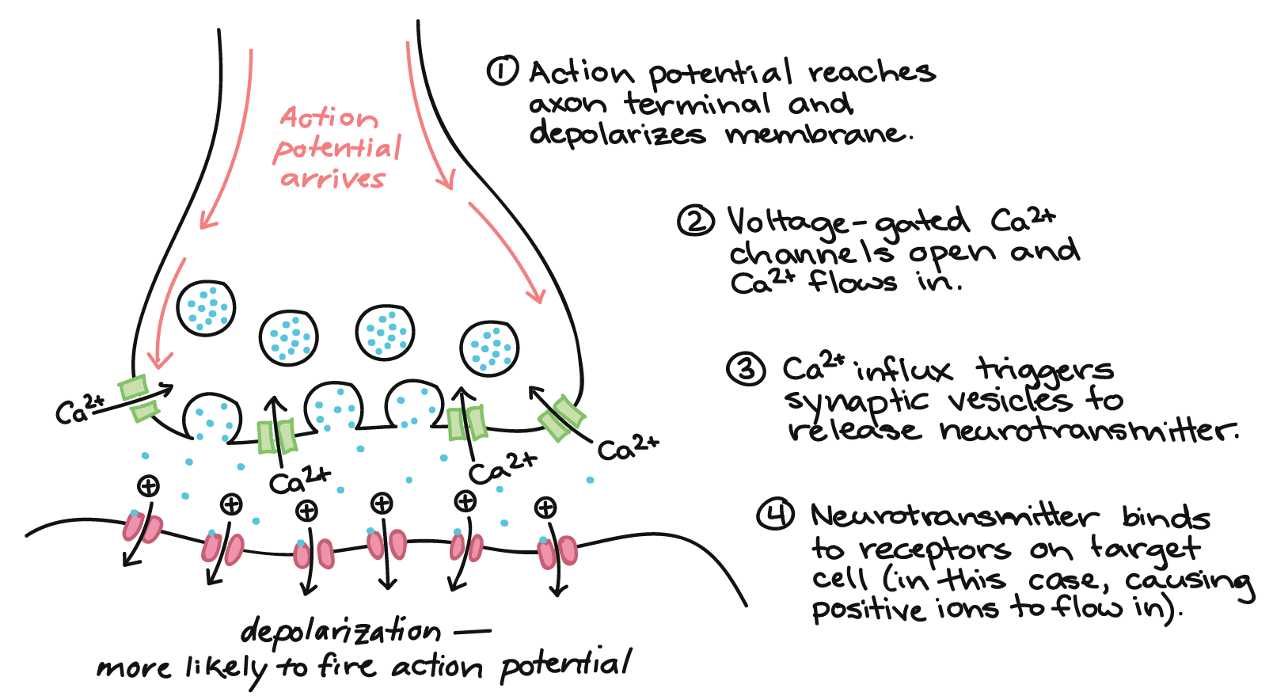
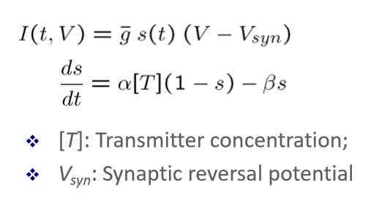
Step 5 - SyNAPse time!
Ampa receptor is not ion specific.
It is a transmitter gated.
It is excitatory and hence Synaptic reversal potential = 0.
At each discrete time step, the Transmitter concentration is assigned to the summed up vesicle release.
https://www.khanacademy.org/science/biology/human-biology/neuron-nervous-system/a/the-synapse

Slide 14
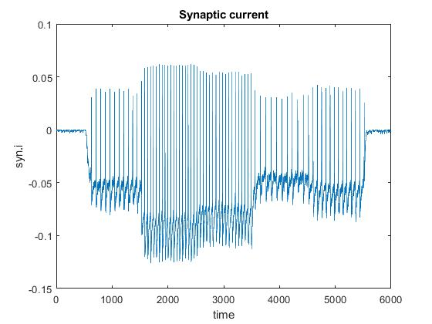
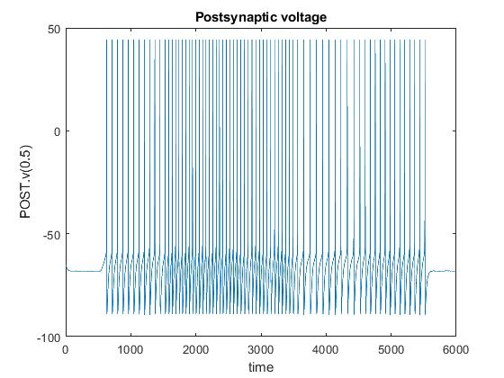
Synaptic current and Postsynaptic voltage traces

Slide 15
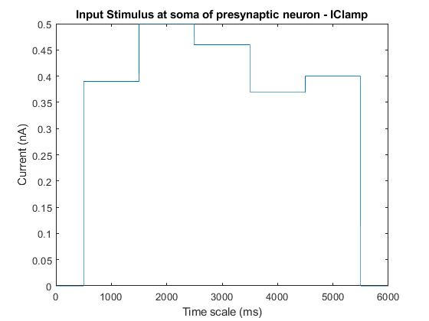
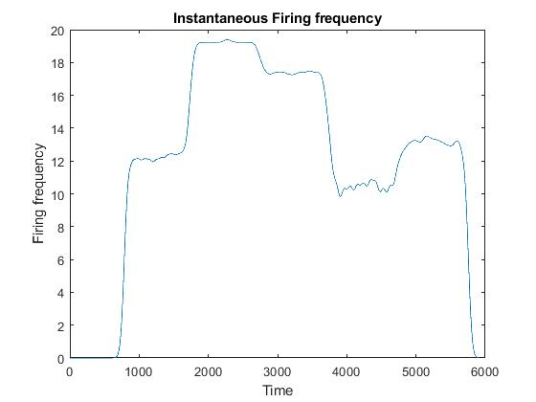
Confirmation for Amplitude Coding!

Slide 16
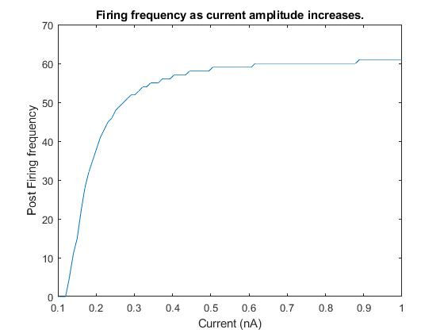
As Amplitude of Stimulus increases, Firing rate of Postsynaptic cell also increases.

Slide 17
Thank you!

